Slide 1



SuperStore Sales Dashboard
View in Power BI
Last data refresh:
6/3/2025 8:58:08 AM UTC
Downloaded at:
6/5/2025 11:32:14 AM UTC

Slide 2
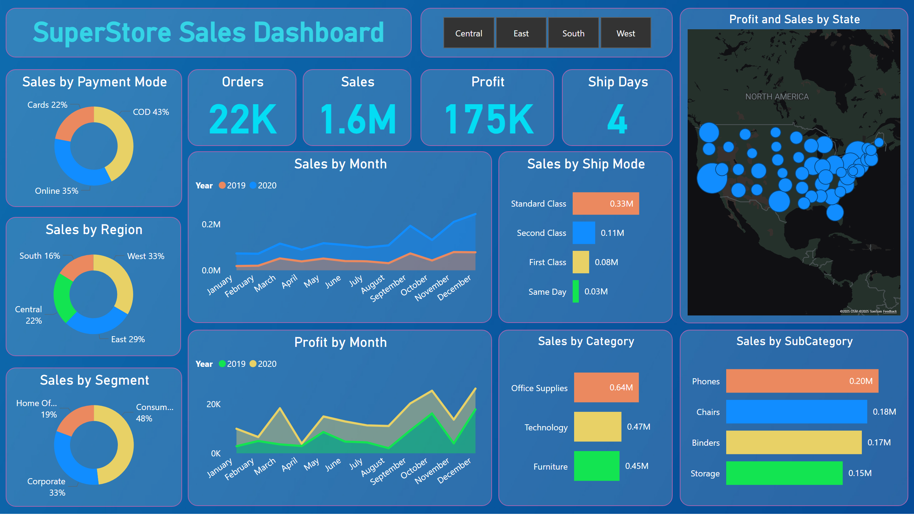
SuperStore Dashboard
Notes:
Sales by Category
No alt text provided
Sales by SubCategory
No alt text provided
Sales by Ship Mode
No alt text provided
Sales by Month
No alt text provided
Profit by Month
No alt text provided
Profit and Sales by State
No alt text provided
Sales by Segment
No alt text provided
Sales by Payment Mode
No alt text provided
Sales by Region
No alt text provided
slicer
No alt text provided
textbox
No alt text provided
Ship Days
No alt text provided
Profit
No alt text provided
Orders
No alt text provided
Sales
No alt text provided

